Slide 1
CUSTOMER SEGMENTATION
HRUTHIK SH
CDACL 002
PTID CDA DEC 25 1098

Slide 2
Introduction
Customer segmentation is a data analysis technique used to group customers based on similar characteristics and behavior. In today’s data-driven businesses, understanding customer segments helps organizations improve marketing efficiency and customer engagement. This project focuses on analyzing customer data using Python to identify meaningful segments. The analysis is performed step by step using Python libraries to explore patterns in customer behavior. The goal is to convert raw customer data into actionable insights. This project demonstrates practical data analysis skills using real-world datasets.

Slide 3
Problem Statement
Many businesses treat all customers in the same manner, which often leads to ineffective marketing and lower customer retention. Without proper segmentation, companies struggle to identify high-value customers and understand purchasing behavior. The challenge is to analyze customer data and categorize customers into meaningful groups. These groups should represent differences in spending habits and engagement levels. Solving this problem enables businesses to target customers more effectively. This project addresses this challenge using Python-based data analysis techniques

Slide 4
Project Objectives
The primary objective of this project is to segment customers based on their purchasing behavior using Python. The project aims to understand patterns related to customer spending and frequency. Another objective is to perform data cleaning and exploratory data analysis to ensure accurate results. The analysis also focuses on identifying high-value and low-value customer groups. Visual analysis is used to interpret trends clearly. Overall, the objective is to support data-driven business decision-making through customer segmentation

Slide 5

Dataset Overview
The dataset used in this project contains customer-level information related to purchasing behavior. It includes attributes such as customer identifiers, transaction details, and spending-related variables. Before analysis, the dataset was examined to understand its structure and data types. The presence of missing values and duplicate records was checked carefully. Understanding the dataset was essential to ensure accurate analysis. This dataset represents real-world customer behavior commonly seen in business environments.

Slide 6
Tools and Technologies Used
Python was used as the primary programming language for this project due to its strong data analysis capabilities. Pandas was utilized for data manipulation, cleaning, and transformation tasks. Matplotlib and Seaborn were used to visualize data distributions and trends. These libraries helped in understanding customer behavior visually. Python provided flexibility to perform step-by-step analysis efficiently. All operations were executed in a structured and reproducible coding environment.

Slide 7
Data Cleaning Process
dtype: int64
 | 0
CustomerID | 0
Age | 0
Gender | 0
ItemPurchased | 0
Category | 0
PurchaseAmountUSD | 0
Location | 0
Size | 0
Color | 0
Season | 0
ReviewRating | 0
SubscriptionStatus | 0
ShippingType | 0
DiscountApplied | 0
PromoCodeUsed | 0
PreviousPurchases | 0
PaymentMethod | 0
FrequencyOfPurchases | 0
Data cleaning was performed as a critical step before analysis to ensure data quality. Missing values were identified and handled appropriately using Python. Duplicate records were removed to avoid biased analysis results. Data types were corrected where necessary to support accurate computations. Inconsistent values were examined and standardized. This cleaning process ensured that the dataset was reliable and ready for exploratory data analysis

Slide 8
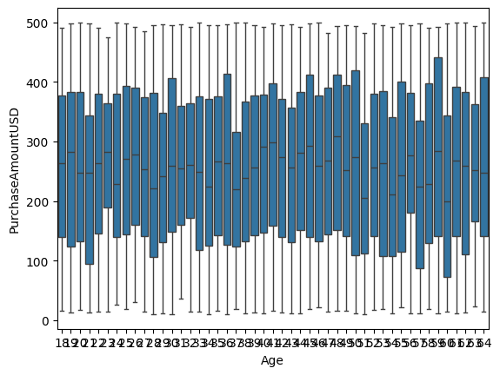
Exploratory Data Analysis (EDA)
Exploratory Data Analysis was conducted to understand customer behavior patterns. Python visualizations were used to analyze distributions of spending and purchase frequency. Relationships between key variables were examined to identify trends. EDA helped in identifying outliers and unusual customer behavior. These insights guided the selection of relevant features for segmentation. Overall, EDA played a crucial role in shaping the segmentation approach

Slide 9
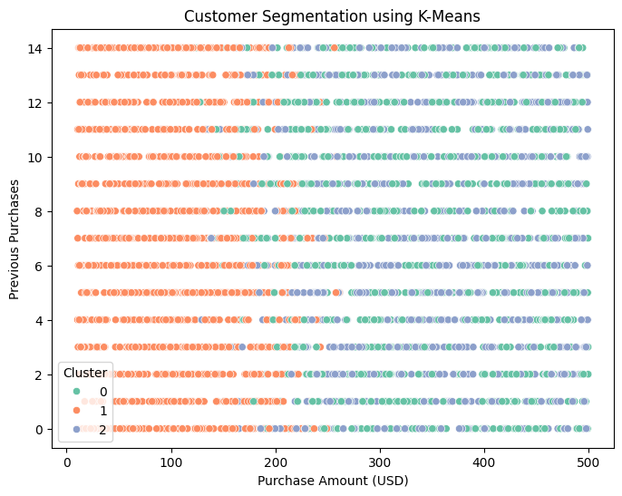
Customer Segmentation Approach
Customers were grouped based on behavioral patterns observed during analysis. Key factors such as spending levels and purchase frequency were considered for segmentation. Python logic was applied to classify customers into different segments. Each segment represents customers with similar characteristics. This approach helped simplify complex customer data into meaningful groups. The segmentation process enabled clearer interpretation of customer value.

Slide 10
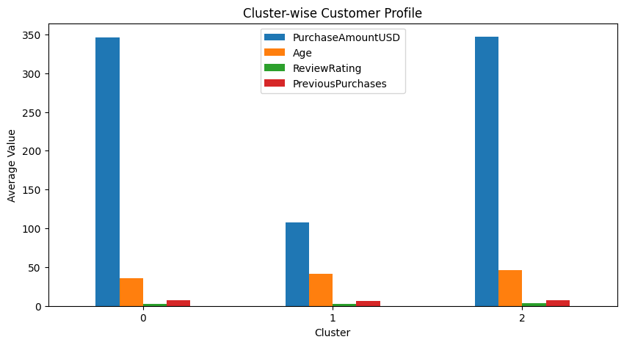
Key Insights and Findings
The analysis revealed clear differences between customer segments. High-value customers were identified based on higher spending and frequent purchases. Medium-value customers showed moderate engagement and spending behavior. Low-value customers indicated opportunities for targeted marketing or re-engagement strategies. These insights provide a strong foundation for business decision-making. The results demonstrate how Python analysis can drive actionable insights

Slide 11

Conclusion and Business Impact
This project successfully demonstrated customer segmentation using Python-based data analysis. The step-by-step approach ensured data accuracy and meaningful insights. Customer segmentation helps businesses optimize marketing strategies and improve retention. The insights generated can be used to focus efforts on high-value customers. This project highlights the practical application of Python in solving real business problems. Overall, it reflects strong analytical and problem-solving skills relevant to Data Analyst roles.

Slide 12
Thank you

